Slide 1
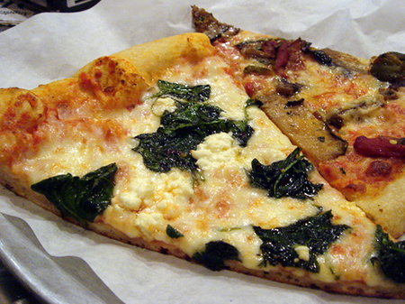
Topic: Rational Numbers EQ: How do I multiply rational numbers?

Slide 2

LESSON OBJECTIVES
I will multiply and divide fractions (find a fraction of a fraction).
I will divide fractions by finding the inverse.

Slide 3
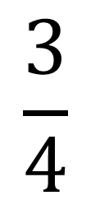
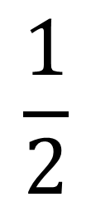
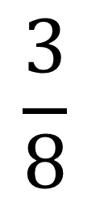
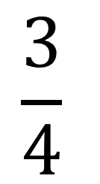
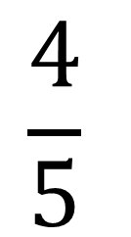
Daily Review
$$\frac{1}{2}$$
$$\frac{3}{4}$$
$$\frac{4}{5}$$
$$\frac{3}{4}$$
$$\frac{3}{8}$$
+
-
+
2

Slide 4
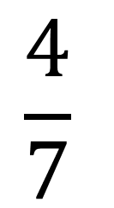
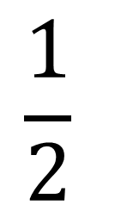
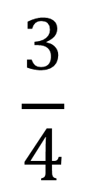
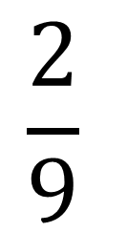
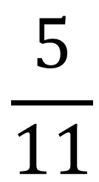
Daily Review
$$\frac{3}{4}$$
$$\frac{4}{7}$$
$$\frac{4}{5}$$
$$\frac{5}{11}$$
$$\frac{2}{9}$$
$$\frac{1}{2}$$
+
-
3
+

Slide 5
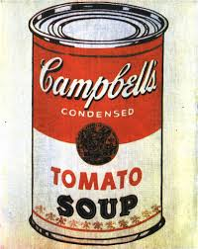
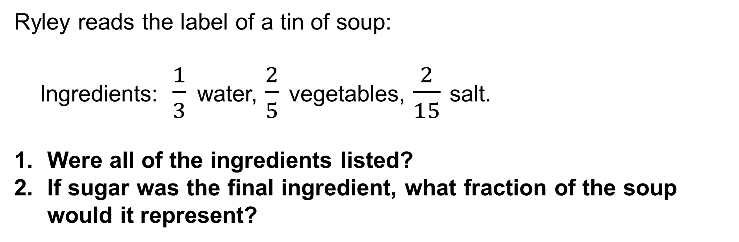
Daily Review
Ryley reads the label of a tin of soup:
Ingredients:$\frac{1}{3}$ water, $\frac{2}{5}$ vegetables, $\frac{2}{15}$ salt.
Were all of the ingredients listed?
If sugar was the final ingredient, what fraction of the soup would it represent?

Slide 6
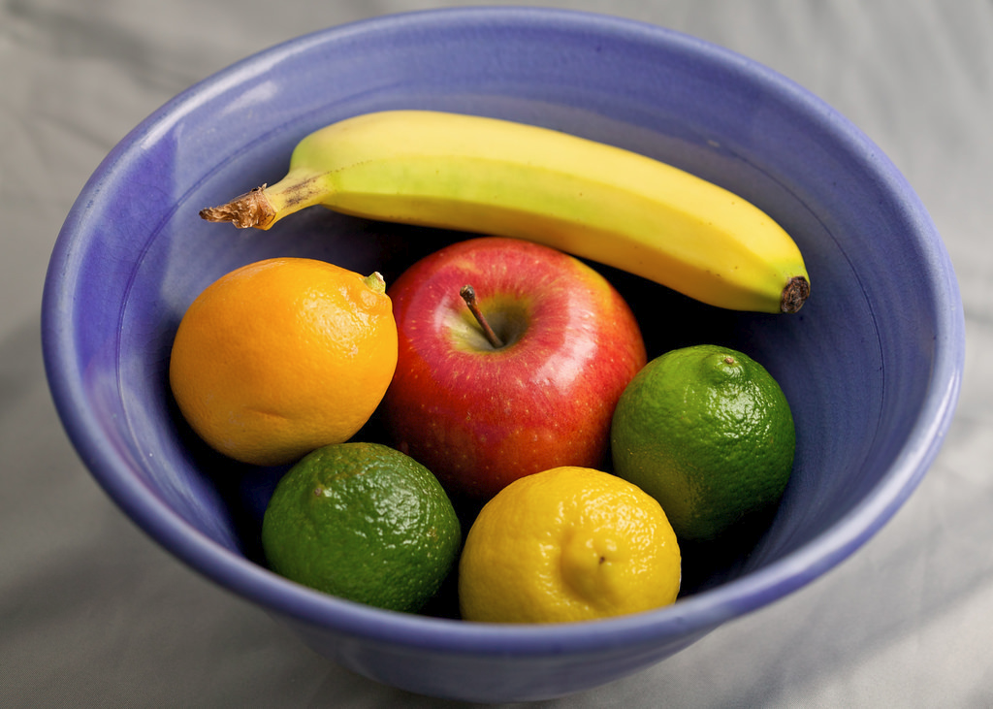
Back to primary school…
What is 3 lots of 6?
3 x 6 = 18

Slide 7

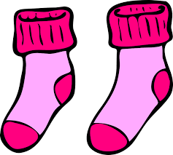

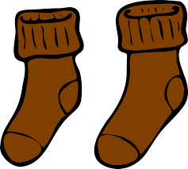
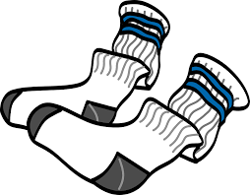
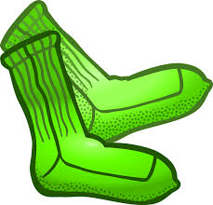
Back to primary school…
4 lots of 6
4 x 6 = 24
3 lots of 6
3 x 6 = 18
5 lots of 2
5 x 2 = 10
When you see ‘lots of’ or ‘of’
replace it with a multiplication sign (x).

Slide 8


Finding a Fraction of a Fraction
(Multiplying Fractions)
Multiply the numerators
1 x 3
3
$$\frac{1}{2}$$
$$\frac{3}{4}$$
x
=
=
2 x 4
8
Multiply the denominators

Slide 9
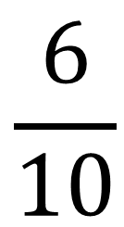
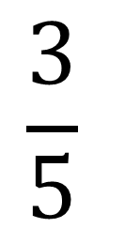
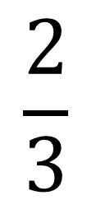
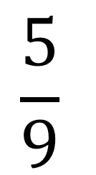
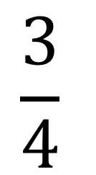
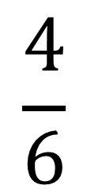
Finding a Fraction of a Fraction
(Multiplying Fractions)
$$\frac{3}{5}$$
$$\frac{4}{6}$$
$$\frac{3}{4}$$
$$\frac{5}{9}$$
$$\frac{2}{3}$$
$$\frac{6}{10}$$
x
x
OF
Multiply the numerators
Multiply the denominators

Slide 10
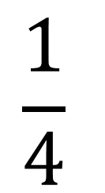
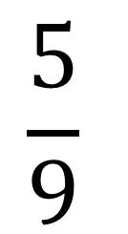
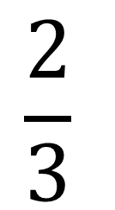
Finding a Fraction of a Whole
(Multiplying Fractions)
$$\frac{1}{4}$$
$$\frac{2}{3}$$
$$\frac{5}{9}$$
3
4
6
x
OF
OF
Multiply the numerators
Multiply the denominators

Slide 11
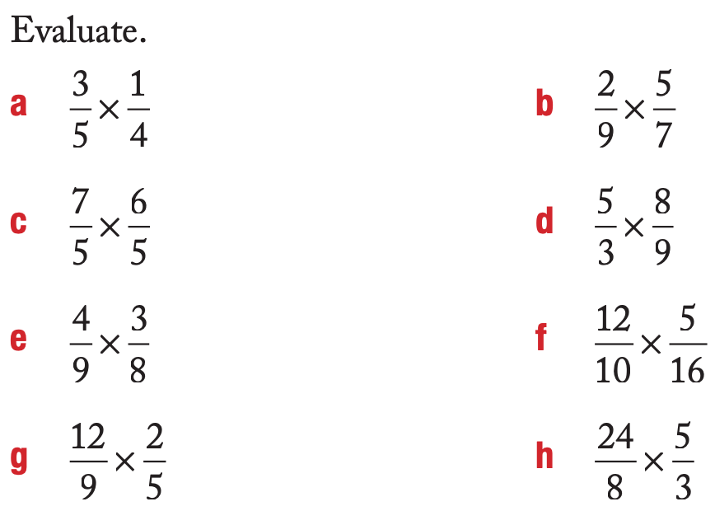
Independent Practice

Slide 12
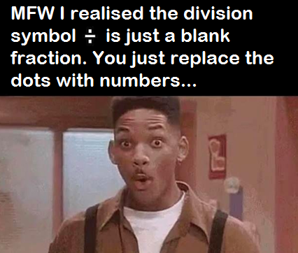
What have we learnt today?
Lesson Objectives:
I will multiply fractions (find a fraction of a fraction).
What do you do when you see the word ‘of’?
Replace it with x

